Slide 1
SafeCircle GBV EMERGENCY SUPPORT APP
Presented by Tumelo(51161338),Okuhle(45050465),Boitumelo(48311340)
SafeCircle
2025

Slide 2
Table of contents
01
02
03
04
Introduction& Team Overview
Challenge Definition
Proposed Solution
How SafeCircle Works
05
06
07
08
Key Features
Community Impact
Business Model&
Support
Conclusion &
Call to Action
SafeCircle
2025

Slide 3
Introduction
01
Team Name : SafeTech Solutions
App Name: SafeCircle
SafeCircle
2025

Slide 4
Our team
Tumelo Seleka
Okuhle Madikwa
Boitumelo Tsotetsi
Role: Project Lead& Slide Developer
Role: Research Specialist & Content Development
Role: Visual Design & Creative Elements
SafeCircle
2025

Slide 5
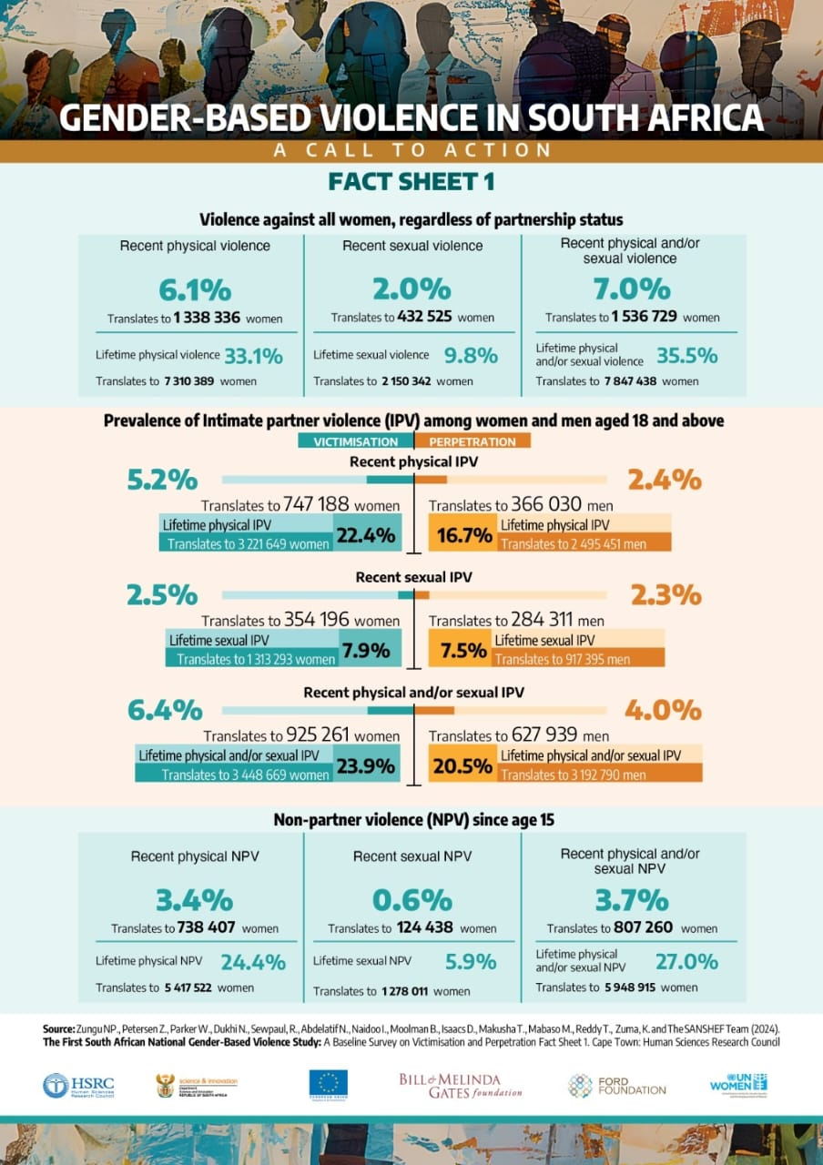
Challenge definition: GBV in South Africa
02
GBV is violence that targets a person based on their gender or that disproportionately impacts people of a specific gender.
According to the World Health Organization, South Africa has the highest stats for GBV in the world. 1 in 3 women has experienced physical or sexual violence in her lifetime.
Causes for GBV are:
Unequal power dynamics between genders
Substance abuse
Negative gender stereotypes
Lack of social and emotional support
Mental health and psychological factors
2025
SafeCircle

Slide 6

Proposed Solution
03
Objective: Reduce gender-based violence (GBV) through accessible, real-time support
Platform: Mobile app with built-in safety features
Target Users: Victims or potential victims of GBV
Impact: Empowers users with tools to act quickly and safely during emergencies
SafeCircle
2025

Slide 7
How SafeCircle Works
04
The system operates through four interconnected elements:
User Profiling
& Registration
SOS Emergency Button & Alert System
Anonymous Reporting Procedure
Access to Resources Support Network
A single-touch emergency alarm that sends location to contacts, triggers silent sound recording, and operates offline
Refers users to national and local support agencies, educational resources, and a 24/7 support network through experts.
Users can register anonymously or as verified users through a personalized safety profile tailored to their specific needs.
A guided reporting process that allows users to submit reports with evidence and secure reporting to authorities.
SafeCircle
2025

Slide 8
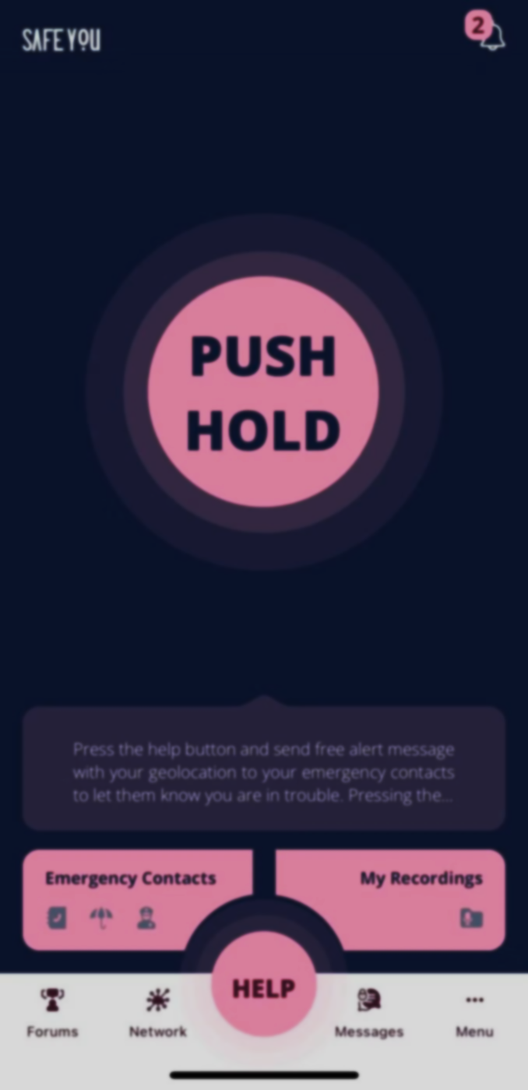
KEY FEATURES
05
Emergency Resources
Anonymity and Privacy
Community Support
Education and Prevention
SafeCircle provides a panic button, real-time location tracking, and a 24/7 helpline for immediate assistance.
The app offers anonymous reporting and secure communication to ensure victims feel safe in seeking help
SafeCircle fosters a community-driven approach by connecting users with support agencies and resources.
The app includes educational content on GBV, helping to raise awareness and prevent future incidents.
SafeCircle
2025

Slide 9
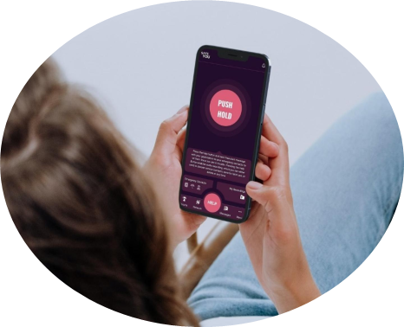
Community Impact
06
Breaking the Cycle of Silence
Coordinated Response
SafeCircle empowers survivors to speak up against GBV, helping to break the cycle of silence and encourage communities to take action against GBV
The app connects disparate support services, reducing intervention time from 27+ minutes to under 8 minutes.
Prevention Through Education
Sustainable Support
SafeCircle also promotes early warning sign recognition and better relationship norms all over the community.
The app fosters local capacity by engaging volunteer networks and peer support and developing long-term community resilience.
SafeCircle
2025

Slide 10
Business Model and Support Strategy
07
Funding Strategy
Apply for grants from organizations that are focused on gender-based violence such as UN Women and Open Society Foundations
Launch crowd funding campaigns on platforms like GoFundMe in-order to receive donations from individuals interested in the app
Propose collaboration with government departments of social development
Partner with tech companies for example Google.org or Microsoft Philanthropies and local telecoms or banks
Support and Maintenance
A helpdesk that is open 24 hours long
Bug Reporting System
Monthly Security updates
Regular surveys to receive user feedback
Optimizing app speed and responsiveness
Ensuring compatibility with new device and operating system
SafeCircle
2025

Slide 11
Conclusion &Call To Action
08
SafeCircle goes beyond the scope of an ordinary mobile application; it is a vital tool for many victims of gender-based violence in South Africa
Together, we have the potential to:
Break the cycle of the existing culture of silence
Reduce response times
Support the creation of stronger and more secure communities
Your gift will help us:
Increase this vital resource
Save lives
Create enduring change
v
Together, we can break the silence, empower survivors, and build a safer future for all.
SafeCircle
2025

Slide 12
—Mbuyiselo Botha
“When we keep quiet, when we look the other way, we are complicit. We are condoning. We are conniving when in fact we do not visibly and practically speak out and call each other out”
#Justice
SafeCircle
2025

